Slide 1
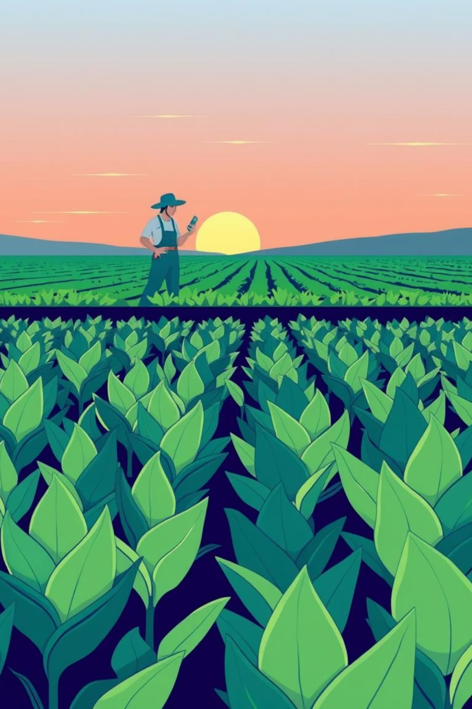
CropWise: Smart Farming for a Sustainable Future
Welcome, investors and program managers. We are Glitchy Gang, and we're here to introduce CropWise, a solution designed to empower farmers with intelligent, accessible crop guidance.

Slide 2
Problem Statement
Farmers lack personalized, timely, and accessible crop guidance.
1
2
3
Language Barriers
Limited Tech Knowledge
Ineffective Advisory Systems
Information often isn't available in local dialects.
Many farmers are new to digital tools.
Existing systems are often slow or generic.
These challenges prevent optimal crop management, leading to lower yields and economic instability for agricultural communities.

Slide 3
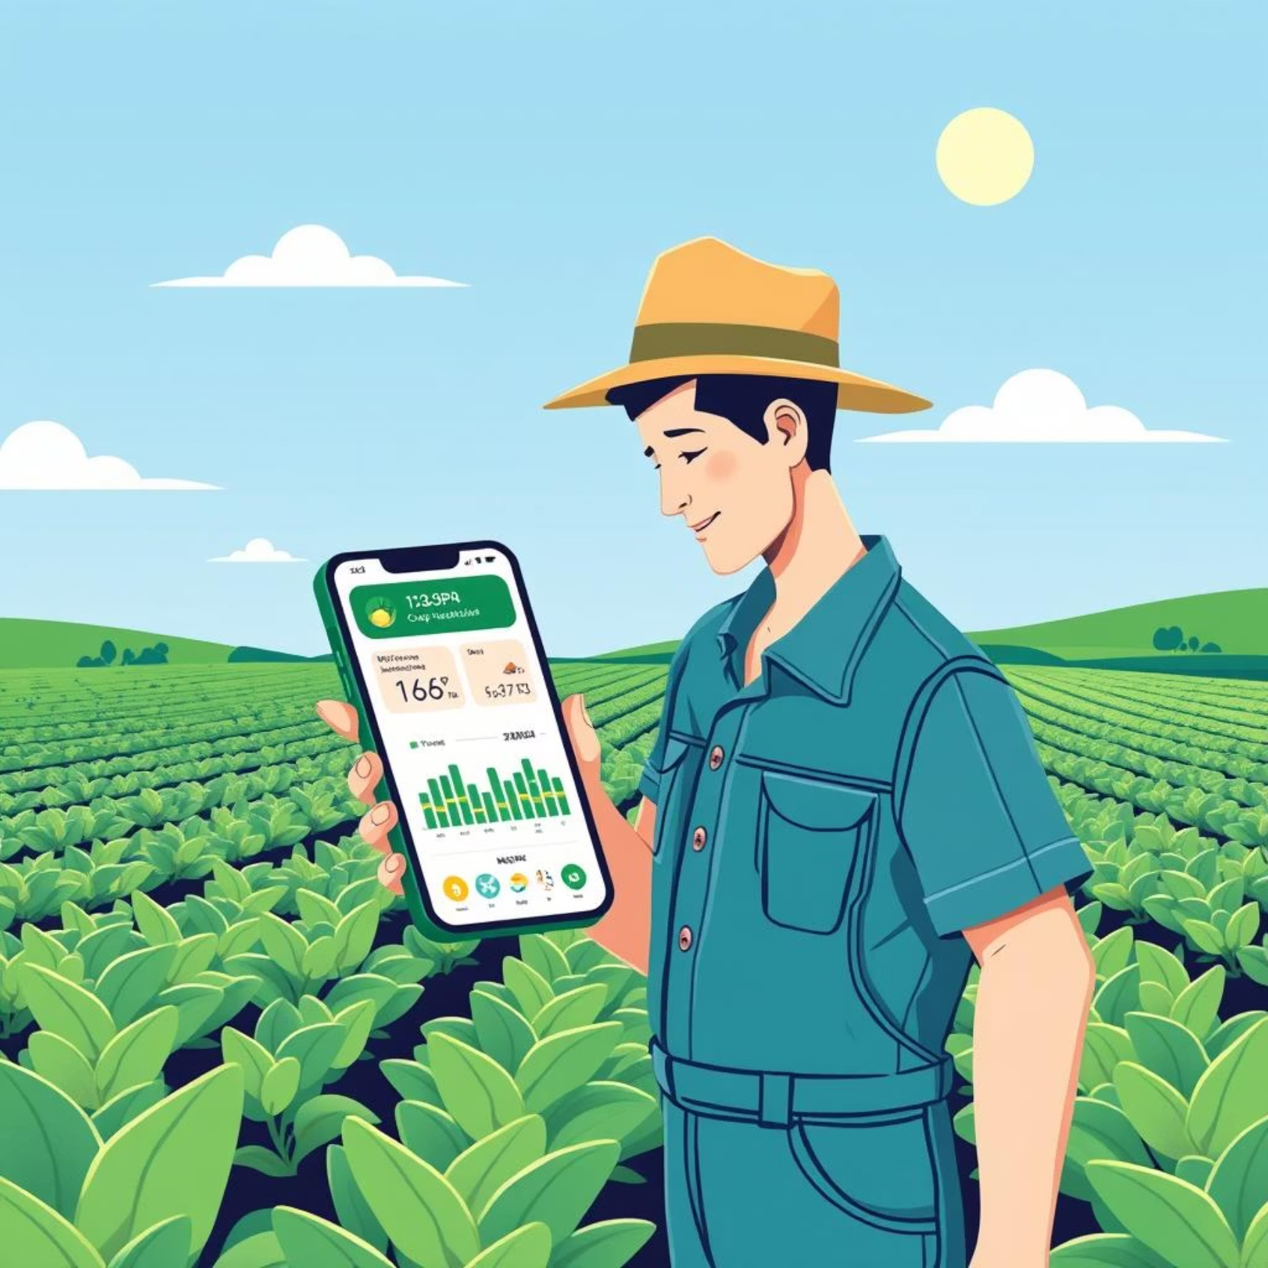
Our Solution: CropWise Mobile App
CropWise is an AI-powered mobile application designed to be the farmer's most reliable companion. It provides smart crop recommendations by analyzing critical data points:
Soil Data: pH, nitrogen level , phosphorus , potassium .
Environmental Factors: Local weather patterns.
Historical Context: Crop rotation history.
More in Demand recommendation:.
Our app breaks down communication barriers by offering multilingual, offline-capable support through voice, text, and image-based queries.

Slide 4





Key Features & App Flow
Home Screen
Instant overview of soil health status: pH, moisture, and NPK levels.
Farm Alerts
Timely notifications on planting feasibility and potential nutrient issues.
Crop Page
Tailored crop recommendations with projected yield, water needs, market demand, and sustainability scores.
AI Chat
Multilingual Q&A support, allowing farmers to interact and ask their query in their language .
Farm Page
Personalized task prioritization and detailed crop rotation history.
Each feature is designed to be intuitive and directly actionable, guiding farmers through every step of the growing cycle.

Slide 5

Technology and Data Foundation
Robust Tech Stack
Comprehensive Data Sources
Machine Learning: Google Colab for advanced model training.
Soil Grids: Global soil information for precise analysis.
Bhuvan APIs: Geospatial data for location-specific insights.
App Development: Flutter for cross-platform mobile experience.
Design & UI/UX: Figma for intuitive and accessible interfaces.
Styling: CSS for responsive and engaging visuals.
Our Machine Learning model forecasts yield, and sustainability scores, providing actionable intelligence to farmers.

Slide 6
Driving Impact and Future Growth
"CropWise will help farmers make data-driven decisions. It increases income, saves resources, and promotes sustainable farming. In the future, we plan to add AI-powered pest and disease detection. We also aim to integrate government agricultural schemes into the app. Our vision is to create a community-driven AI support system for farmers."
Our commitment is to revolutionize agriculture by empowering farmers, ensuring higher yields, efficient resource utilization, and a more sustainable future for global food production.

